Slide 1
Collaborative Care:
Moving from Research to Practice
Jürgen Unützer, MD, MPH, MA
Chair, Psychiatry and Behavioral Sciences
Founder, AIMS Center
University of Washington
UCLA Integrated Care Conference
October 24, 2018

Slide 2

Jürgen Unützer, MD, MPH, MA
Professor & Chair, University of Washington Department of Psychiatry and Behavioral Sciences
Founder, AIMS Center: Advancing Integrated Mental Health Solutions
Adjunct Professor, Health Services; Global Health, UW School of Public Health
DISCLOSURES
Grant funding
National Institute of Health National Corporation for Community Service (Social Innovation Fund) Center for Medicare and Medicaid Innovation | John A. Hartford Foundation Archstone Foundation PCORI (Patient Centered Outcomes Research Institute)
Contracts
Community Health Plan of Washington, Public Health -- Seattle & King County | New York State Department of Health
Consultant, Advisor, or Affiliate Kaiser Permanente Washington Research Institute Substance Abuse and Mental Health Services Administration (SAMHSA; CMHS) Author with Royalties Up To Date | World Health Organization

Slide 3
Overview
Part 1: Collaborative Care
Part 2: Lessons from Translating
Research to Practice

Slide 4
Part 1
Collaborative Care

Slide 5
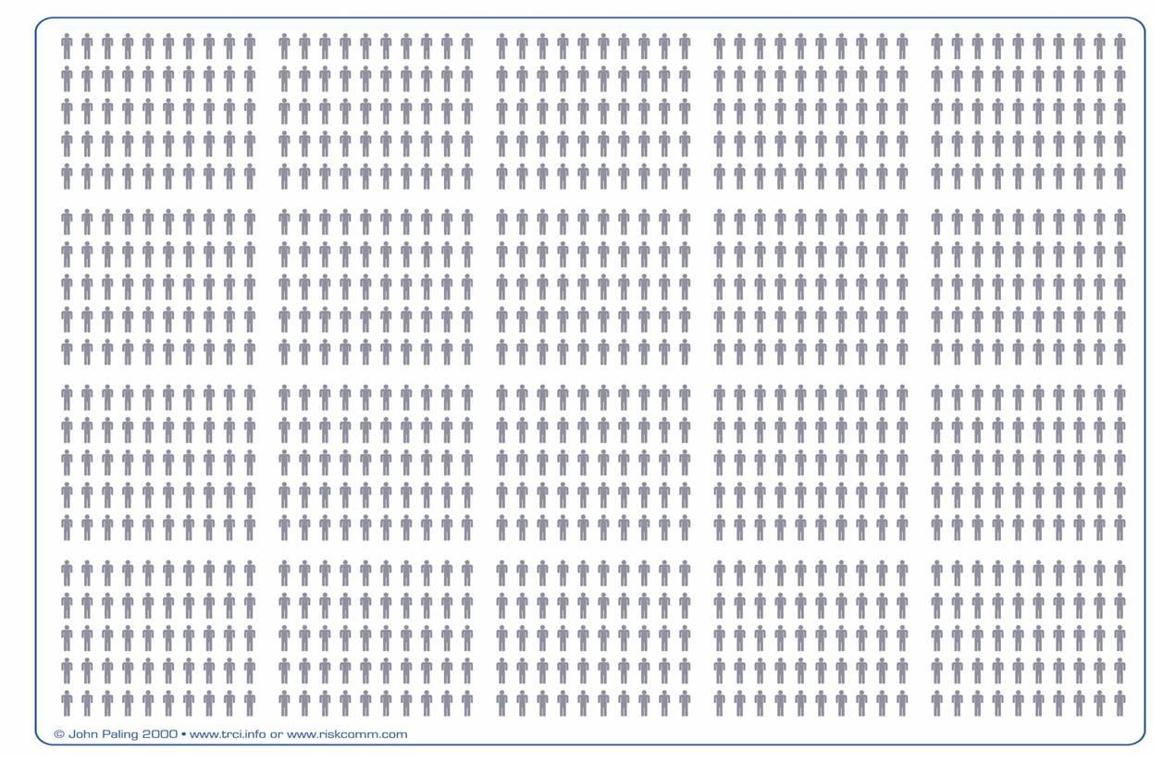
Of all people living with mental disorders
Data from Wang PS et al. Arch Gen Psychiatry 2005; 62(6): 629-640.

Slide 6
12% see a psychiatrist

Slide 7
20 % see any mental health professional

Slide 8
40 % get mental health treatment in primary care

Slide 9
Most get no formal mental health care

Slide 10
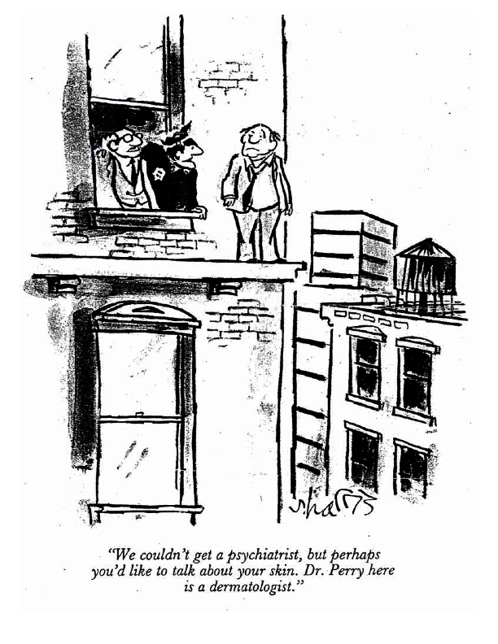
Access to Care
Even with insurance, the average wait time is 25 days to see a mental health specialist.
2/3 of primary care providers report poor access to mental health care for their patients.
Only 1/10 Americans with a substance use disorder receive specialty care.
“We couldn’t get a psychiatrist, but perhaps you’d like to talk about your skin. Dr. Perry here is a dermatologist.”
Notes:
Turn now to access for mental health.
Most individuals with mental health problems do not get any formal or informal care for their condition (41%), with even fewer getting formal health services (36%) or even fewer getting specialty mental health services (22%). 12% See a psychiatrist.
While this is a very serious problem, it is even worse in rural areas than in urban ones.

Slide 11
Mental Health Workforce
Who are we?
  Psychiatrists (MD, DO) > 40,000
  Psychologists (PhD, PsyD) > 100,000
  Psychiatric Nurses / Nurse Practitioners > 20,000
  Social Workers (MSW, LCSW) > 100,000
  Counselors: √ LFMT,√ LPC, √ CADAC, √ MHC, √ CACC
Concentrated in select urban areas
  < 5 % in rural / underserved areas
Psychiatry
  more than half are 60 years or older
  half of office-based psychiatrists don’t accept insurance

Slide 12
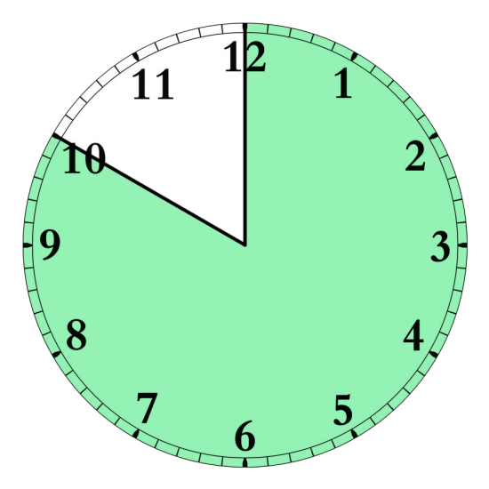
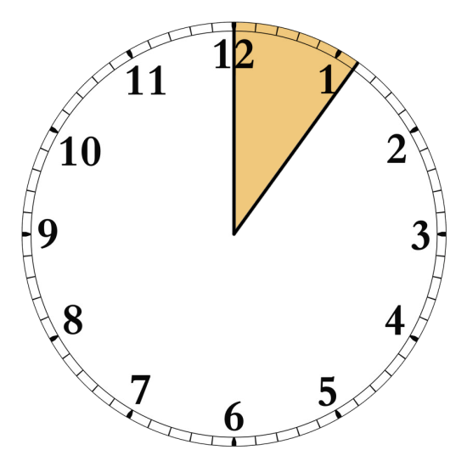
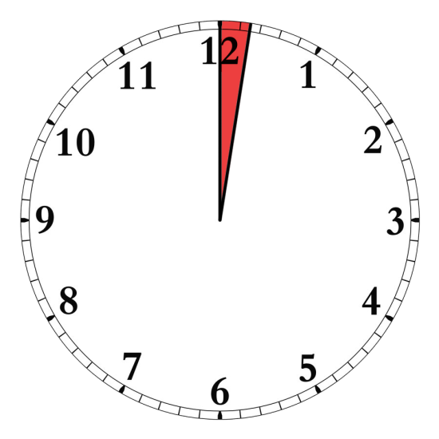
“The 50 minute hour”
Ideal
  50 minutes
Urban US
  6 minutes
Rural US
  1.5 minutes
Assuming that 3 % of population could benefit from psychiatric care.

Slide 13
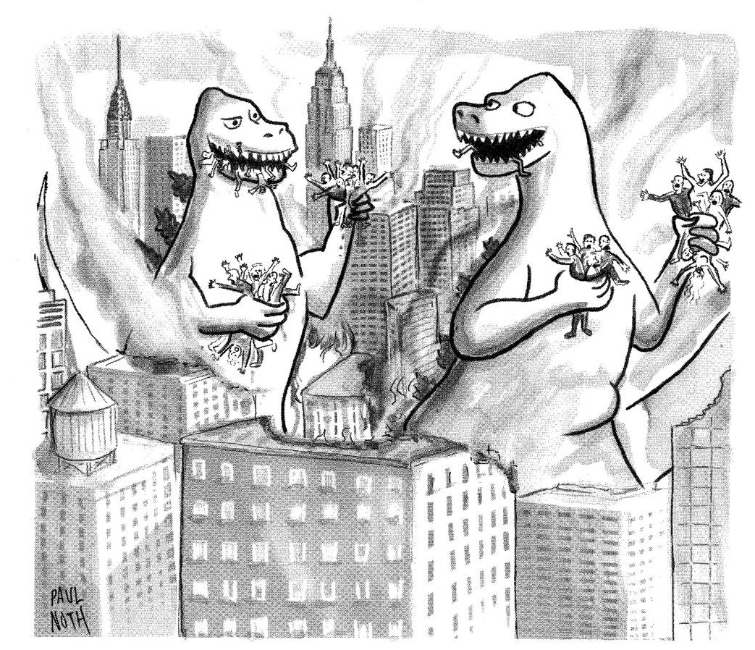
Quality of Care
Each year ~ 30 million Americans receive a prescription for psychiatric medication (mostly in primary care) but only 25% improve.
Patients with serious mental illness die 10 – 20 years earlier.
“Of course you feel great. These things are loaded with antidepressants.”
Notes:
Turn now to access for mental health.
Most individuals with mental health problems do not get any formal or informal care for their condition (41%), with even fewer getting formal health services (36%) or even fewer getting specialty mental health services (22%). 12% See a psychiatrist.
While this is a very serious problem, it is even worse in rural areas than in urban ones.

Slide 14
How do we close the gaps?
Train & retain more mental health professionals
Work smarter
  Work upstream (e.g., perinatal MH)
  Focus on populations at risk (disparities)
  Leverage mental health professionals through
    Partnerships (collaborate with primary care, schools, etc)
    Technology (telehealth, HIT)

Slide 15
Task Sharing: we need all hands on deck
“You have no idea how much lunch there is.”
Hospital
Community Mental Health Care
Collaborative Care
Behavioral Health Consultant
Primary Care Provider
Community-based Care
Specialty Care
Primary Care
Community

Slide 16

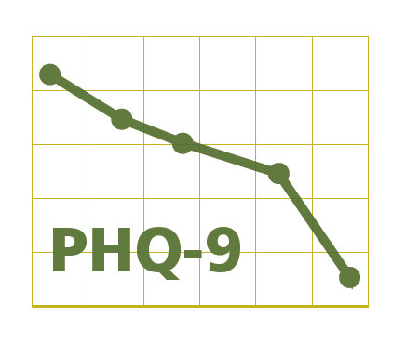
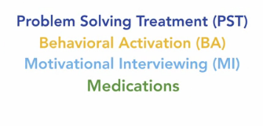
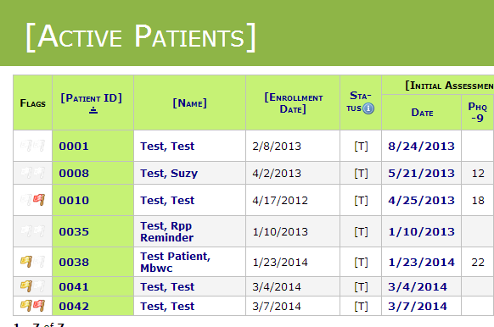
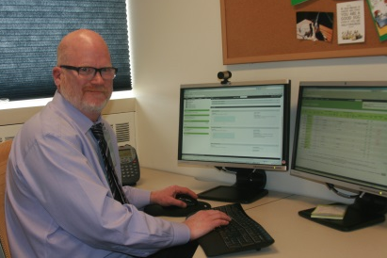
Collaborative Care
Primary Care Practice
Primary Care Physician
Patient
+
Mental Health Care Manager
Psychiatric Consultant
Outcome
Measures
Treatment
Protocols
Population
Registry
Psychiatric
Consultation

Slide 17

Collaborative Care Doubles Effectiveness of Care for Depression
50 % or greater improvement in depression at 12 months
Percentage (%) Improved
Participating Organizations
Unützer et al., JAMA 2002; Psych Clinics North America 2004

Slide 18
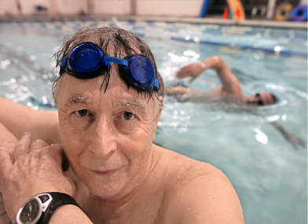
Collaborative Care achieves the ‘quadruple aim’ of health care reform
Better care experience
  Access to care
  Client & provider satisfaction
Better health outcomes
  Less depression
  Less physical pain
  Better functioning
  Better quality of life
Lower health care costs
More satisfied providers
“I got my life back”

Slide 19
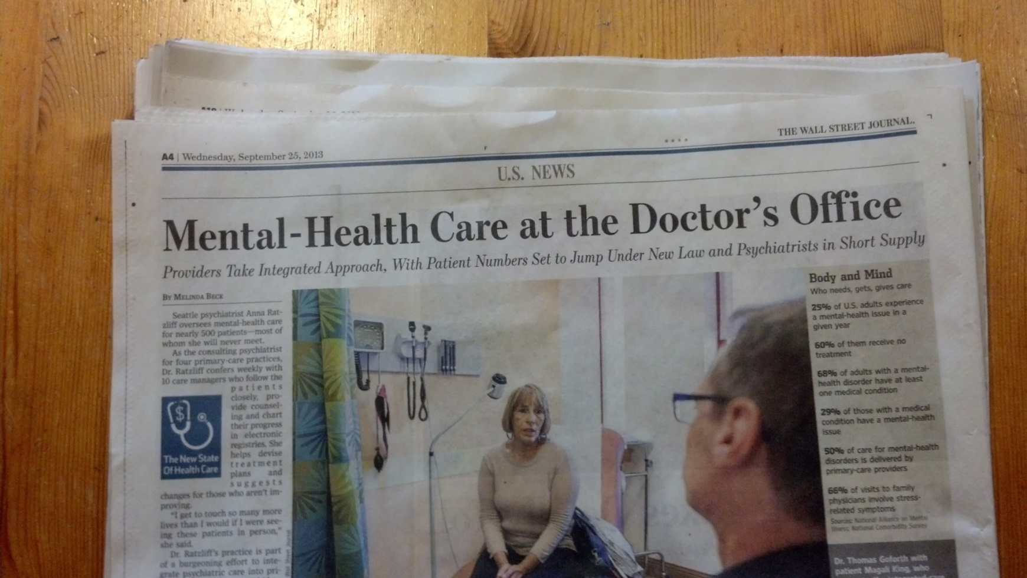
Wall Street Journal, Sept 2013
ROI for collaborative depression care:$ 6.50 for each $ 1.00 spent
Unutzer et al, Am J Managed Care, 2008.

Slide 20
Replication studies show: the model is ‘robust’
Clinical Setting | Target Clinical Conditions | Reference
Primary Care for Adolescents | Adolescent Depression | Richardson 2009, 2014
Adult primary care | Depression & Diabetes Depression, Diabetes, Heart Disease | Katon et al., 2004 Katon et al, 2010
Latino patients in safety net clinics | Diabetes and depression | Gilmer et al., 2008 Ell et al 2010
Public sector oncology clinic | Cancer and depression | Ell et al., 2010
Women’s health care clinics (IDAWN) | Depression, PTSD | Melville 2014 Katon 2014
Adult primary care | Anxiety Disorders including PTSD | Roy-Byrne et al 2012
Older adults in primary care | Arthritis and depression | Unützer et al., 2008
Primary Care / Cardiology (COPES) | Heart disease and depression | Davidson et al., 2010
Notes:
20
Day 1
20
20

Slide 21
Evidence Base for Collaborative Care
More than 80 randomized controlled trials have shown Collaborative Care to be more effective than usual care for common mental health conditions such as depression and anxiety.

Slide 22





Principles
Patient-Centered Collaboration. Primary care and behavioral health providers collaborate effectively using shared care plans.
Population-Based Care. A defined group of clients is tracked in a registry so that no one falls through the cracks.
Evidence-Based Care. Providers use treatments that have research evidence for effectiveness.
Treatment to Target. Progress is measured regularly and treatments are actively adjusted until clinical goals are achieved.
Accountable Care. Providers are accountable and reimbursed for quality of care and clinical outcomes, not just volume of care.

Slide 23
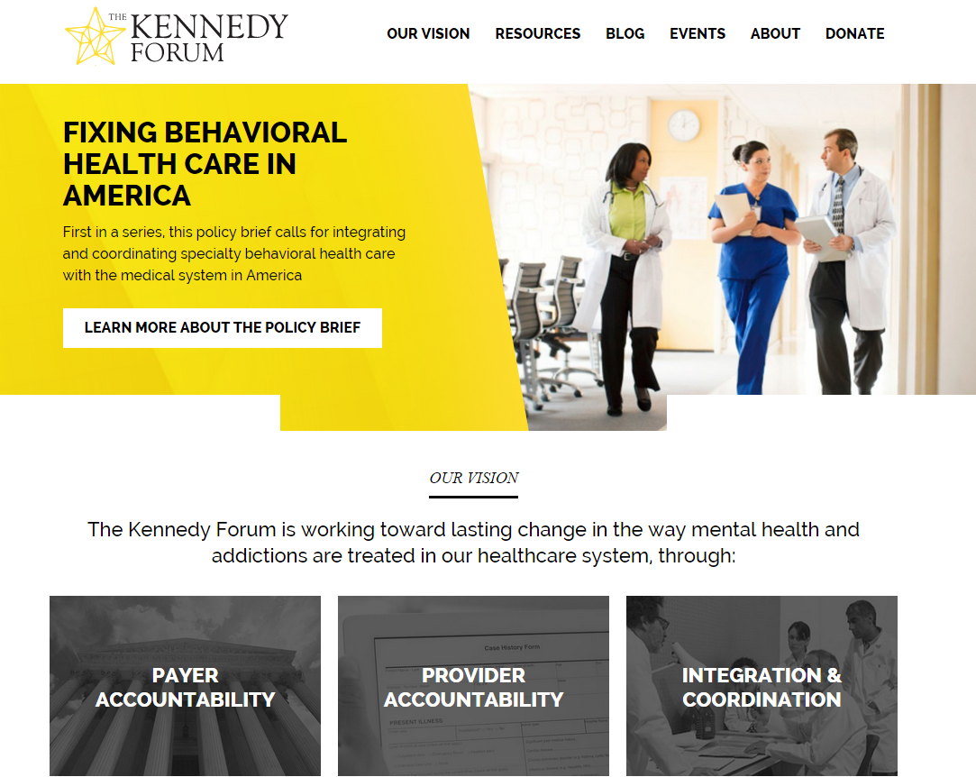
http://kennedyforum.org

Slide 24
Part 2
Translating from research to practice: practice, payment, and policy change to implement collaborative care.

Slide 25
“crossing the valley of death”

Slide 26


Trained more than 5,000 clinicians in some 1,000 clinics in evidence-based collaborative care.
http://aims.uw.edu
Notes:
Who we are slide.

Slide 27

And the bottom line …

Slide 28
Why is this so hard? things that researchers often don’t think about.
Patients are not asking for this.
  Don’t know what they are missing.
  Don’t feel comfortable (stigma).
  Have competing priorities (“I need other things from my doctor.”)
  Taking a pill is fairly easy. Making change is hard.
Providers have mixed feelings.
  We were not trained for this. This is ‘outside of our scope of practice.’
  Isn’t there a button that says “refer to psychiatry?”
  What do you mean my treatments aren’t always effective?
  Why worry about patients who aren’t in our waiting room?
Programs and Practices
  Why make change? We just got things working fine.
  How will we get paid for this?
  What if we get audited?
  What about the cost of making all of this change?
  It may not work as well in our practice as it did in research.
Policy makers
  Who will benefit from this change and who will be upset?
    Constituent groups may not be aligned.
    Budgets are often in silos.
    Providers may not want to change or be able to change.
  What are the competing priorities?

Slide 29
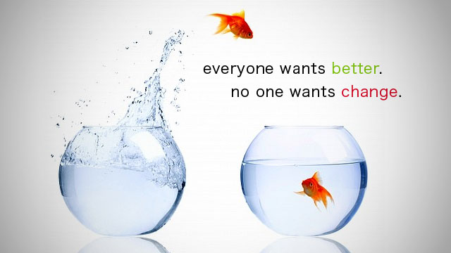
Implementing collaborative care requires change.

Slide 30



AIMS Center Training at a Glance
Pre-Launch Training
In-Person Clinician Training
Post-Launch Coaching/Technical Assistance
Focuses on coaching/technical assistance for care managers and psychiatric consultants
On-going distance learning
Monthly 60 to 90 minute webinars & case calls for care managers
Webinar topics for care managers include:
  patient engagement
  treating to target & follow-up
  relapse prevention
  working with difficult patients
Monthly and/or quarterly case calls for psychiatric consultants, with an emphasis on the weekly systematic case review process
Focuses on building skills that are critical to teams delivering care in a new way, such as:
  Effective team communication
  Identifying common implementation challenges
  Brief behavioral interventions
  The Care Manager’s Role
Emphasis on experiential, active learning
1-2 days of time required, depending on role
We recommend that this training occur within 1-2 weeks before launching care
Focuses on building foundational knowledge around the evidence-base and key components of Collaborative Care and team roles
1.5 to 2 hours of time required, depending on role
Delivered as self-paced online learning modules
Typically completed 1 month prior to in-person training

Slide 31
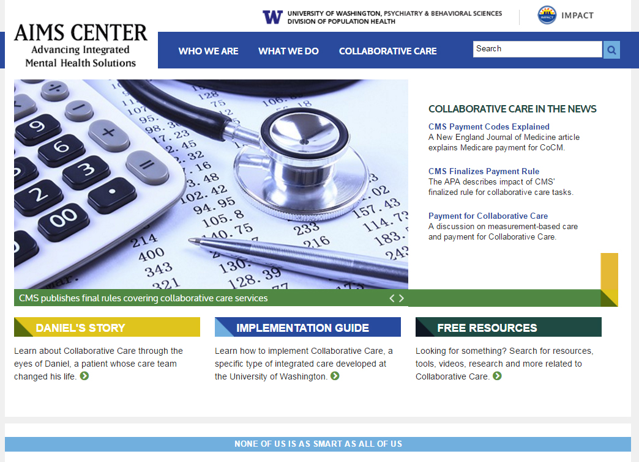
http://aims.uw.edu

Slide 32

New Book Focuses on
Building Effective Integrated Care Teams
Refine clinical approaches used in primary care
Learn integrated care best practices
Gain practical implementation skills
Increase access, improve outcomes, lower costs

Slide 33
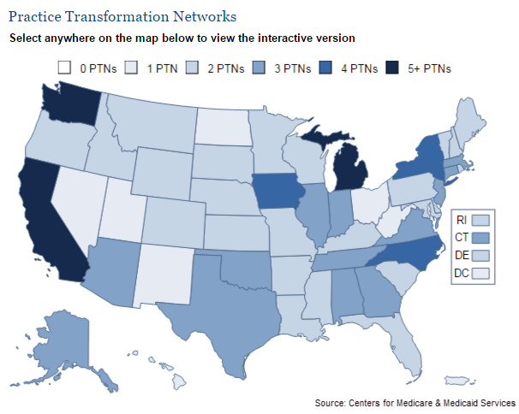

Center for medicare and medicaid services (CMS)
Transforming clinical practice initiative (TCPI)
Support and alignment Network (SAN)
Over 2200 psychiatrists and 200 PCPs trained
CONNECT/
IMPLEMENT
TRAIN
READY
Learning Collaboratives
In Person Trainings
Online Training

Slide 34
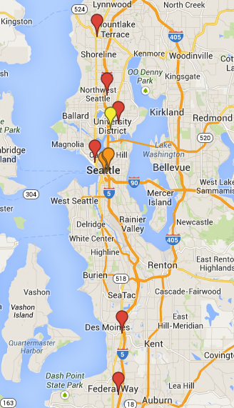
Behavioral Health Integration Program (BHIP) at UW Medicine
2014 APA Award of Distinction for
Model Program
20% of UW Medicine Primary Care Patients have at least one visit with a mental health diagnosis
2008
2010
2012
2013
2014
2016
3 HMC
      1 UWNC
      4 UWNC
      1 UWMC
      1 UWNC
      1 HMC
      3 UWNC
      3UWNC
      2 VMC
      20 Participating Clinic Sites:
      Harborview Medical Center (HMC):
      University of Washington Medical Center (UWMC)
      University of Washington Neighborhood Clinics (UWNC)
      Valley Medical Center (VMC)
      NOTE: 19 year gap between research & full implementation

Slide 35
UWNC Primary Care Physician
Sept 2013
“You have no idea how helpful it is for a provider to have a resource like you in the clinic. I practiced for 16 years without it and I will never go back! You are such a great support for all of us.”

Slide 36
UW Psychiatrist
“I am helping so many more people than I used to see in traditional office practice.”
“The greatest benefit of the MHIP consultation program may be in the diagnosis and treatment of patients that aren’t even in the program.”
[Building capacity]
“Every consultation is a chance to teach.”

Slide 37
Stories and champions can be more persuasive than a JAMA or a NEJM article.

Slide 38

Washington State Healthcare Authority
Community Health Plan of Washington
Public Health Seattle & King County

Slide 39
Mental Health Integration Program (MHIP)
More than 50,000 clients served in > 100 primary care clinics

Slide 40
MHIP Client Diagnoses
Diagnoses | %
Depression | 71 %
Anxiety (GAD, Panic) | 48 %
Posttraumatic Stress Disorder (PTSD) | 17 %
Alcohol / Substance Abuse | 17 %
Bipolar Disorder | 15 %
Thoughts of Suicide | 45%
… plus acute and chronic medical problems, chronic pain, substance use, prescription narcotic / opioid misuse, homelessness, unemployment, poverty.

Slide 41
MHIP: Pay for Performance initiative cuts median time to depression treatment response in half
Log-rank test for equality
of survivor functions, p<0.001
Unutzer et al, American Journal of Public Health, 2012

Slide 42
Particularly effective in high risk moms
Log-rank test for equality
of survivor functions, p<0.001

Slide 43
Mayo Clinic Study of over 7,000 patients
Time to depression remission was 86 days for patients in Collaborative Care program
Time to remission in usual care was 614 days
  Time to Remission for Depression with Collaborative Care Management in Primary Care http://www.ncbi.nlm.nih.gov/pubmed/26769872

Slide 44
… but there is often a ‘voltage drop.’
Efficacy > Effectiveness > Real world.
  “It works if you do it right.” (WK)
  “Some things are easier to break than others.”
Partial implementations work partially
  DIAMOND (no psychotherapy)
  STEPS-UP (a “few touches”)
    Would a “touch of chemotherapy” work?
“You get what you pay for”
  Pay for Performance
Technology can help
  Task sharing through people and technology

Slide 45
Money matters: payment for Collaborative Care
FFS payment does not
cover much of the important work (care management, case reviews)
focus on outcomes / value.
Grant funding
Capitated care
  KP, VA
  but budgets may still be siloed
Bundled / Episode-based care
  DIAMOND, MHIP
Collaborative Care Codes
  CMS (FFS Medicare in 2017)
  Adoption is challenging in FFS-based billing systems
    A new ‘valley of death’?
    Mixed methods research on implementing new codes

Slide 46
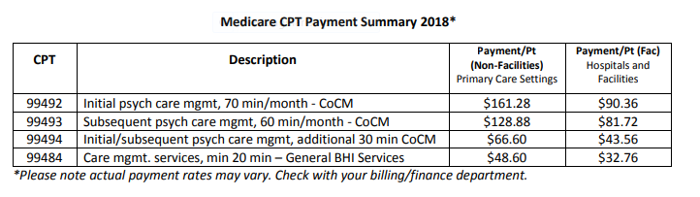
Collaborative Care Billing Codes

Slide 47
Lessons - 1
Research as we know / do it takes time.
  Mental illness is common in primary care: 1985-1995
  Usual Care is limited in reach & effectiveness: 1990-2000
  Collaborative Care works better than care as usual: 1995-2005
  Collaborative Care can be adapted for diverse populations: 2005- 2015
  Collaborative Care can be delivered using technology: 2010- present
Good research can challenge the status quo and shows us what is possible.
  A good randomized trial is a very powerful tool.
  With enough grant $ you can create virtually any reality.

Slide 48
Lessons - 2
The valley of death is real
  Practice change is hard at all levels.
  D&I Research may help with this …
  May need more $ for distribution than for R&D
  We need to be clear about WIIFM
  Persistence is underrated.
    There is nothing as powerful as an idea whose time has come. (V. Hugo)
What else can we try?
  Make our research more relevant. Would people change anything?
    Clinical work provides a powerful reality check.
  Focus on ‘demand’ rather than ‘supply’. What do people really want?
  Design bigger, better, and cheaper experiments.
  Fail faster.

Slide 49
Thank you!
unutzer@uw.edu
http://uw.aims.edu

